Slide 1

Twitter sentiment Analysis Over time
Natasha Kamtekar | LING 1340

Slide 2
Motivation
Saw how social media interactions had changed over the course of my time on the internet– wanted to examine in what ways it had changed.
Wanted to see how different topics were talked about.

Slide 3
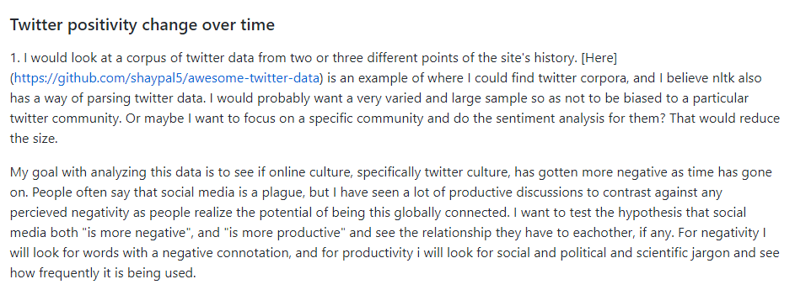
Motivation - Proposal

Slide 4
The Data
Used a diachronic dataset from September 2011 and October 2019.
JSON files
Trained a classifier with data from Sentiment140, a classification tool with open source data. Data was organized into positive and negative sentiments.
Initially data was very large and hard to work with, more recent techniques of big data came in handy.

Slide 5
Initial Hypothesis
Twitter has gotten more negative with time.

Slide 6
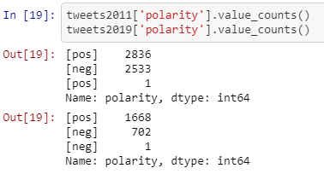
Visualization
53% Positive in 2011
70% Positive in 2019

Slide 7
Initial Thoughts
There was no clear way to contextualize this.
The data ended up somewhat lending itself to the opposite. There were more tweets tagged with “negative” in 2011. There was also more profanity used in the 2011 negative tweets.
This made me consider changing gears and look at different aspects of the data.

Slide 8
Initial Data
Tried scraping my own tweets but I would only get about 100 or 200 at a time and they were super messy. All of them were also based on a keyword or hashtag (which is not what I wanted at the time)
When I found the diachronic files I could only use a small fraction of the total data because of my computers processing limits. This was made even smaller after getting rid of non-English tweets.

Slide 9
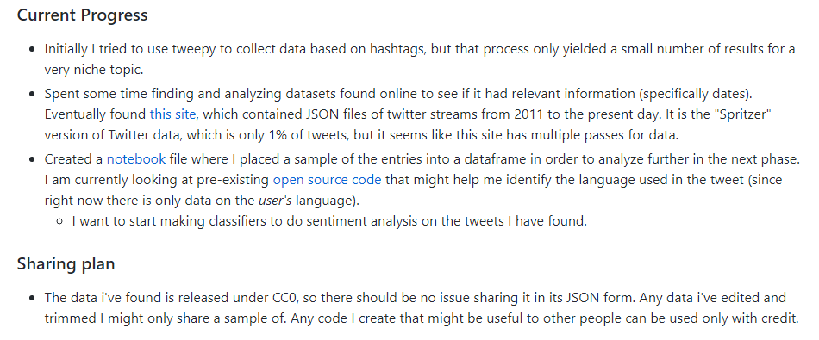
Progress Report 1

Slide 10
Cleaning The Data
Removed non-English words using langdetect.
Removed stopwords using nltk’s English library.
After first round of analysis, cleaned out any additional text lingo stop words that were very frequent such as “u”
Removed punctuation and links.
Kept RT because it indicated engagement and conversation.

Slide 11


Building Classifier
Classifier data was already spilt into “0” which was negative and “4” which was positive. I renamed them.

Slide 12
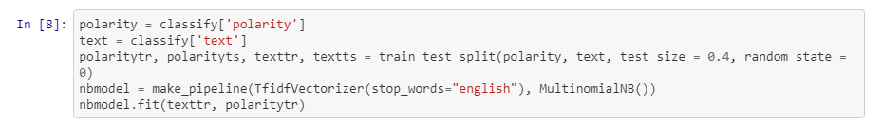

Building Classifier
Using pipeline to build a multinomial naïve bayes model with a 76% accuracy.

Slide 13
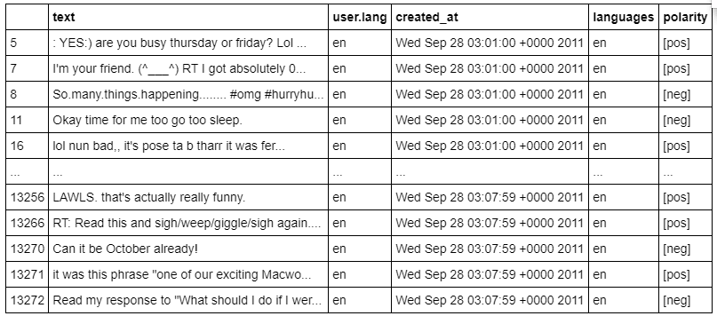
Example of Data After Classification

Slide 14
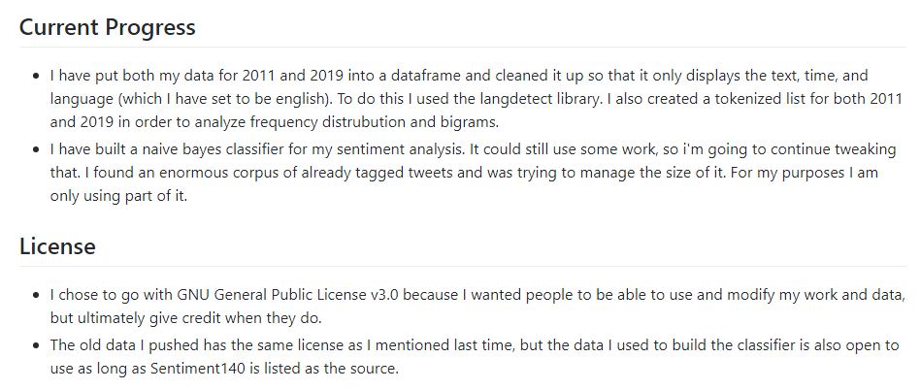
Progress Report 2

Slide 15
Analysis
Frequency Distribution and most common words
Looked at n-grams of the tokens in order to contextualize certain frequently occurring words within their positive/negative contexts
Looking at time of day– when do negatively connotated tweets occur
Looking at content- negative tweets in 2019 are more political, negative tweets in 2011 are about not being able to get a burrito.

Slide 16
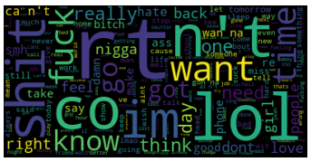
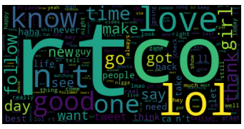
Visualization
Still working on that part…
Created word clouds and showed frequency distribution both overall and then with a positive or negative tilt.
2011 Negative Words
2011 Positive Words

Slide 17
Visualization
Positive engagements had more “RT” interactions.
Negative engagements had more profanity.
They both “LOL” a lot
2011 Negative Words
2011 Positive Words

Slide 18
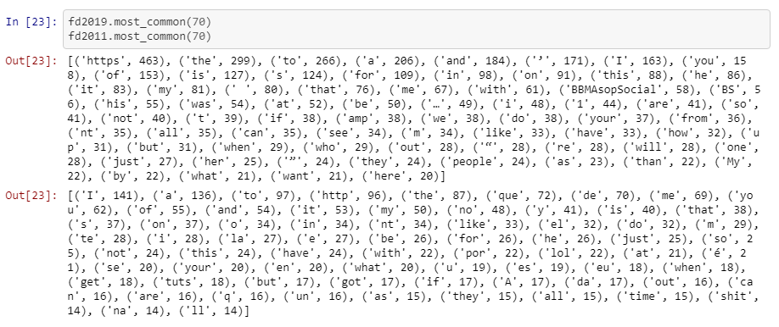
Visualization
Looking at most common words in general
(includes stopwords)

Slide 19
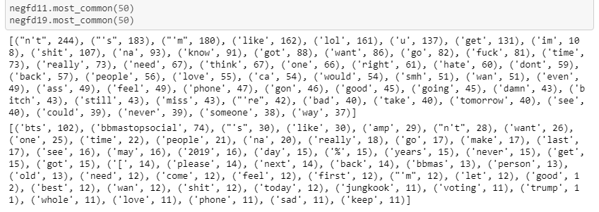
Visualization
Looking at only most common negative words

Slide 20
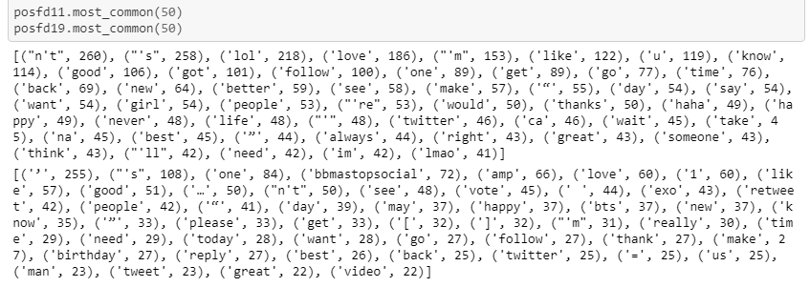
Visualization
Looking at only most common positive words

Slide 21
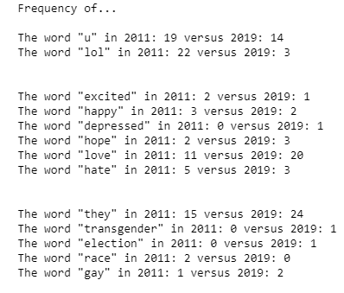
Visualization
This is from my smaller dataset:
I divided them up into a few groups:
Texting lingo
"Feeling" words
Current topics of conversation in pop culture

Slide 22
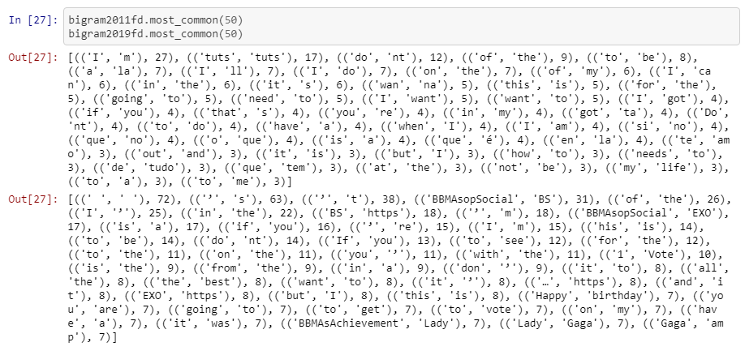
Visualization
Looking at bigrams

Slide 23
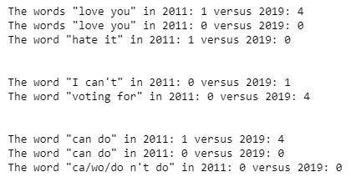
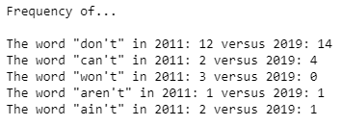
Visualization
Looking at bigrams

Slide 24
Project evolution
Initially wanted to look at “positivity”, but that was too vague which made it hard to pin down what kind of analysis I should do.
Decided to shift focus on comparing the two different time periods in general. Zeroed in on topics of the tweets and contextualized them with the positivity analysis.

Slide 25
What’s Next?
Now that I feel comfortable wrangling messy tweets it would be cool to look into…
User demographics when it comes to some of the types of tweets that I analyzed.
There’s always more improve with how I cleaned data and how I classified it.
Analyze texting lingo specifically instead of ignoring it.
Lot’s of things!

